Slide 1

Cafe Food Ordering System
A cloud-deployed web application streamlining food ordering and cafe management
Presented by CLOUD SURFERS:- Submitted To:-
Shakshi Kumari Prof. Rohit Choubey
Anshika Nigam
Pratha Solanki
Harshita Nihale
Saubhagya Pillai

Slide 2
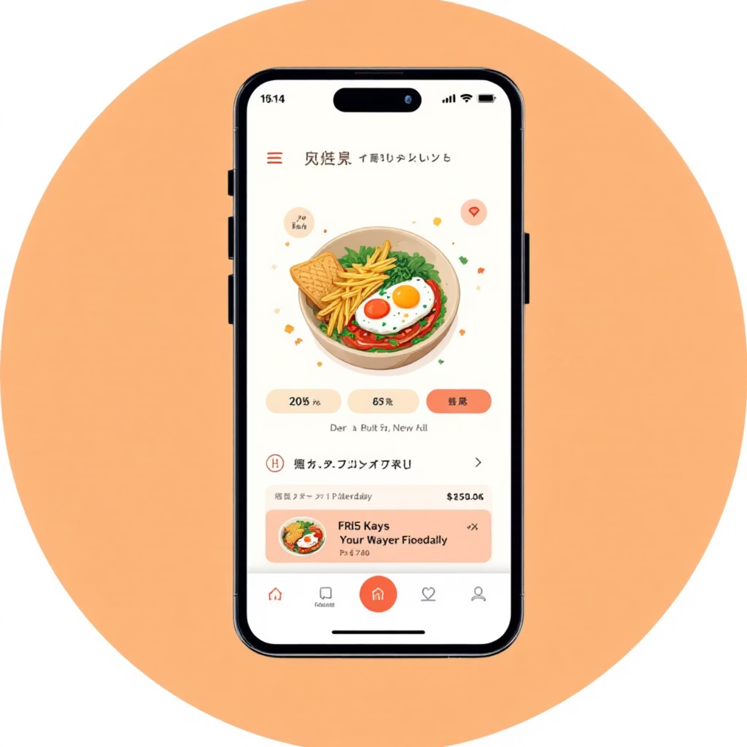
Project Overview
The Cafe Food Ordering System is a comprehensive web-based platform designed to modernize the food ordering experience. Built with scalability in mind, this cloud-deployed solution bridges the gap between customers seeking convenience and cafe administrators requiring efficient operational tools.
This system transforms traditional cafe operations by digitizing the ordering process, reducing wait times, and providing real-time menu management capabilities. The application serves dual purposes: empowering customers with seamless online ordering while equipping administrators with robust order and inventory management tools.

Slide 3

Core Features
Place Orders
Manage Orders
View Menu
Customers can browse the complete menu catalog with descriptions, pricing, and availability. The intuitive interface allows for easy item selection, customization, and cart management before checkout.
Administrators gain full visibility into incoming orders with real-time updates. The dashboard enables order status tracking, fulfillment management, and customer communication throughout the ordering lifecycle.
Dynamic menu presentation showcases cafe offerings with rich descriptions and visual appeal. Customers can filter by categories, dietary preferences, and availability to find exactly what they're craving.

Slide 4

Technology Stack
01
02
Flask Framework (Python)
SQLite3 Database
Lightweight yet powerful web framework handling routing, request processing, and template rendering for rapid development
Efficient relational database storing menu items, customer information, and order history with seamless Python integration
03
HTML & CSS Frontend
Responsive user interface ensuring optimal viewing experience across devices with clean, modern design principles

Slide 5
Backend Architecture
Flask Application Core
Database Integration
from flask import Flask, render_template, requestapp = Flask(__name__)@app.route('/')def index(): return render_template('index.html')
import sqlite3conn = sqlite3.connect('cafe.db')cursor = conn.cursor()
SQLite3 provides a lightweight, serverless database solution perfect for our cafe system. The connection object manages database interactions while the cursor executes SQL queries for data retrieval and manipulation.
The Flask framework serves as the backbone of our application, handling HTTP requests and rendering dynamic templates. Routes define URL endpoints that map to specific functions, enabling clean separation of concerns.

Slide 6
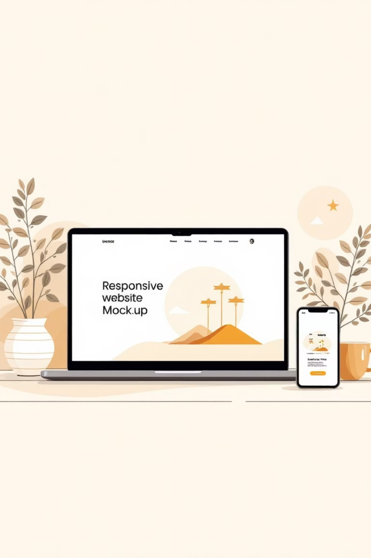
Frontend Implementation
Menu Item Component
<div class="menu-item"> <h3>{{ item.name }}</h3> <p>{{ item.description }}</p> <button>Add to Cart</button></div>
The frontend leverages HTML templating with Jinja2 syntax for dynamic content rendering. Each menu item is presented as a reusable component displaying name, description, and an action button. CSS styling ensures visual consistency and responsive behavior across different screen sizes, creating an engaging user experience that encourages exploration and ordering.

Slide 7





System Workflow
Customer Browses Menu
Users access the website and explore available menu items with real-time availability status
Order Placement
Selected items are added to cart, reviewed, and submitted through secure order processing
Database Storage
Order details are stored in SQLite database with timestamp and customer information
Admin Notification
Cafe administrators receive instant notification of new orders through the management dashboard
Order Fulfillment
Staff prepares the order and updates status, triggering customer notifications for pickup

Slide 8

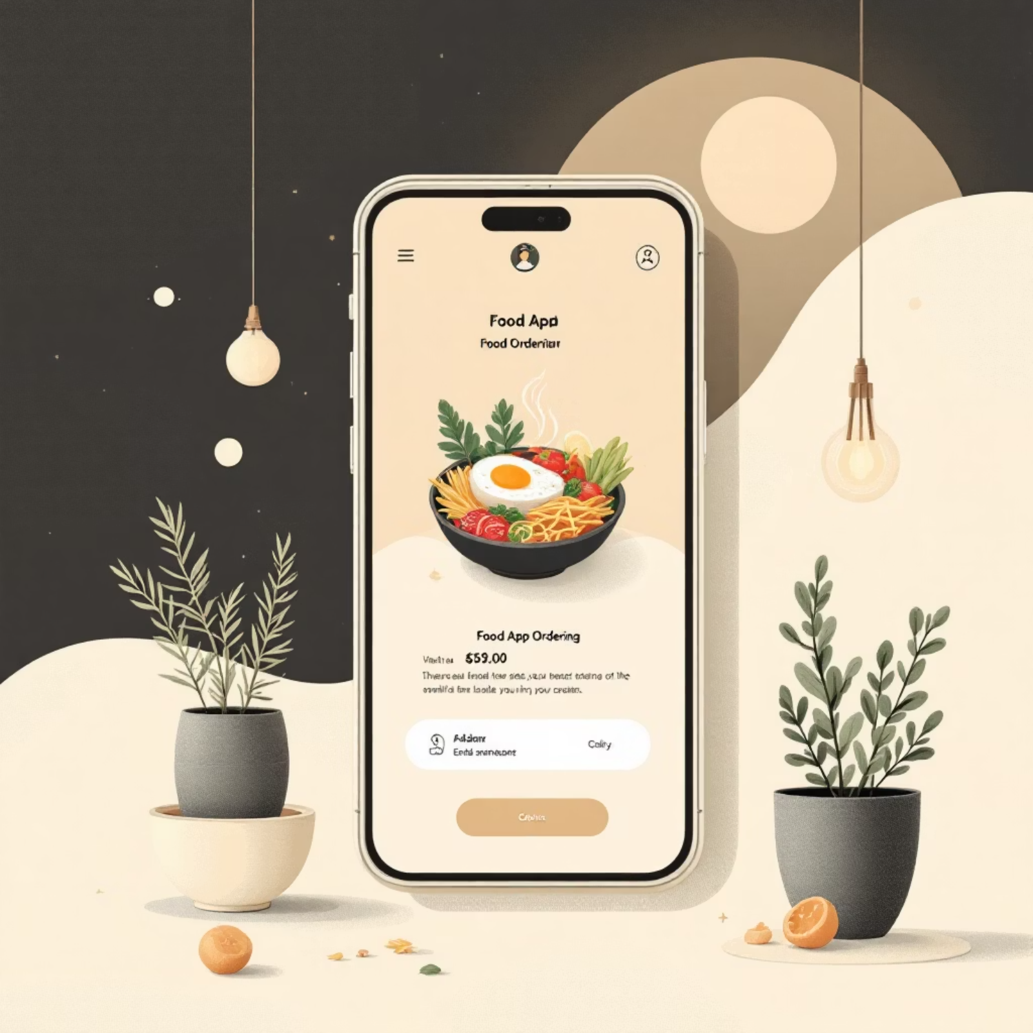
Live System Demonstration
Experience the Platform
Our deployed system showcases the complete ordering workflow from customer perspective and administrative control panel. The demonstration highlights intuitive navigation, responsive design, and seamless order management capabilities.
Key Demonstration Points:
Browse dynamic menu with category filtering
Add items to cart and modify quantities
Submit orders with confirmation feedback
View administrator dashboard with order management
Update menu items and pricing in real-time
The system is fully functional and cloud-deployed, demonstrating production-ready capabilities.
anshika6305.pythonanywhere.com

Slide 9
Future Enhancements
1
2
3
Payment Gateway Integration
Order Tracking System
Enhanced Security & Scalability
Implement secure online payment processing with support for credit cards, digital wallets, and contactless payments to enable complete end-to-end transactions within the platform.
Develop real-time order status notifications with SMS and email alerts, allowing customers to track their order from preparation through ready-for-pickup stages with estimated completion times.
Strengthen authentication mechanisms with user account management, implement SSL encryption, and optimize database architecture to handle increased traffic and concurrent orders efficiently.
These enhancements will transform the system from a functional prototype into a comprehensive enterprise solution capable of serving high-volume cafe operations while maintaining excellent user experience.

Slide 10

Thank You
Questions & Feedback Welcome
We appreciate your time and attention in reviewing the Cafe Food Ordering System. This project demonstrates practical application of web development principles, database management, and cloud deployment strategies to solve real-world business challenges in the food service industry.

